Slide 1
University of Piraeus
Testing
Messaging – Based Microservices
Apostolou Athanasios (mpsp 2203)
Birmpakos Georgios (mpsp 2220)
Evangelou Ioannis Alexandros (mpsp 2210)

Slide 2
Testing
Messaging – Based Microservices
01
Testing Consumer Messaging
Creating xUnitTest Project for Testing Consumer Messaging
Adding Dependencies and writing testing Code
02
Testing Producer Messaging
Creating xUnitTest Project for Testing Producer Messaging
Adding Dependencies and writing testing Code
03
Testing
Running the Consumer Messaging Test
Running the Producer Messaging Test

Slide 3
Testing Consumer Messaging

Slide 4
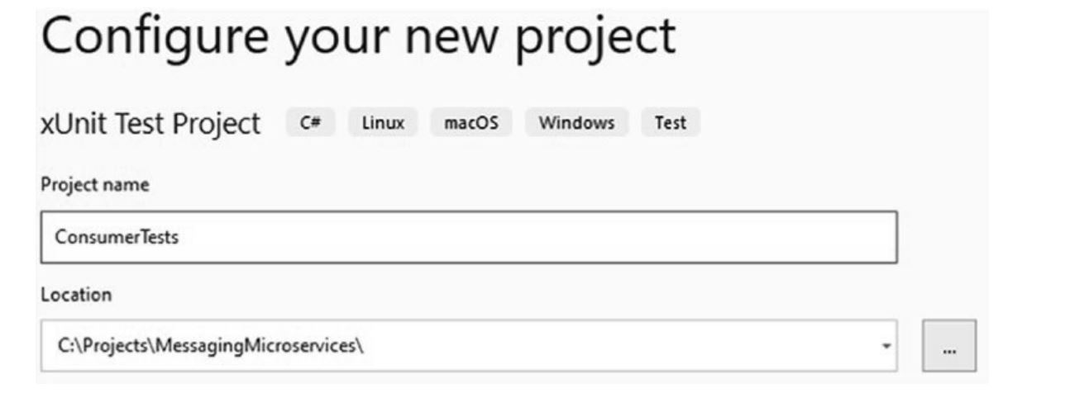
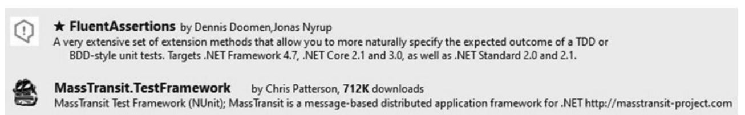
Testing Consumer Messaging
1
Creating the xUnitTest
2
Making Project Reference to Payment Microservice & Adding the FluentAssertions and MassTransit.Test Framework NuGetDependencies

Slide 5
Testing Consumer Messaging
3
Implementing the UnitTest1 code for Consumer Test
The xUnit test is used to test the consumption and publishing of messages in your MassTransit-based microservices. It's a test to verify that when an IInvoiceCreated message is published, it is properly consumed by the consumer and the messaging behavior is as expected.
It verifies that only one instance of the message was published. This test ensures that the messaging interactions between the producer (publisher) and the consumer are working as expected in a controlled testing environment.

Slide 6
Testing Producer Messaging

Slide 7
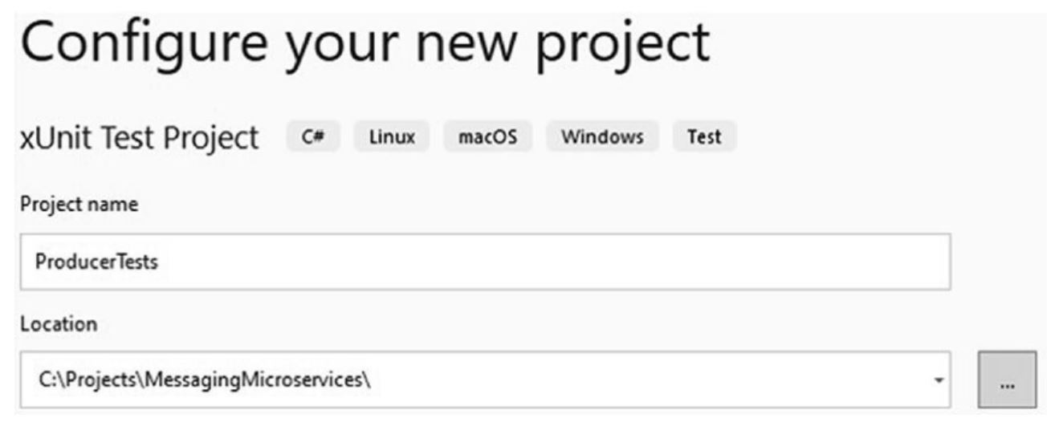
Testing Producer Messaging
1
Creating the xUnitTest
2
Making Project Reference to Invoice Microservice & Adding the FluentAssertions and MassTransit.Test Framework NuGetDependencies

Slide 8
Testing Producer Messaging
3
Implementing the UnitTest1 code for Producer Test
The xUnit test code is used to test the sending and consumption of IInvoiceToCreate messages in your MassTransit-based microservices. This test aims to verify that when an IInvoiceToCreate message is sent to the input queue, it is properly consumed by the consumer and triggers the expected behavior.

Slide 9
Testing

Slide 10
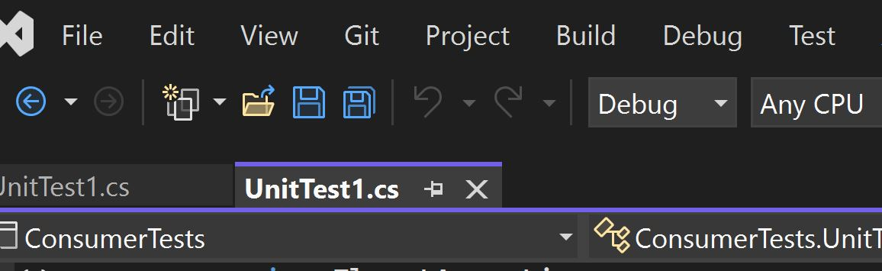
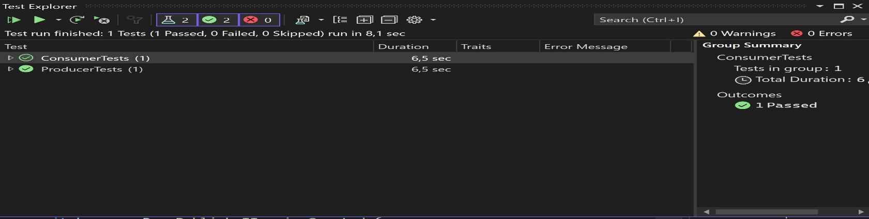
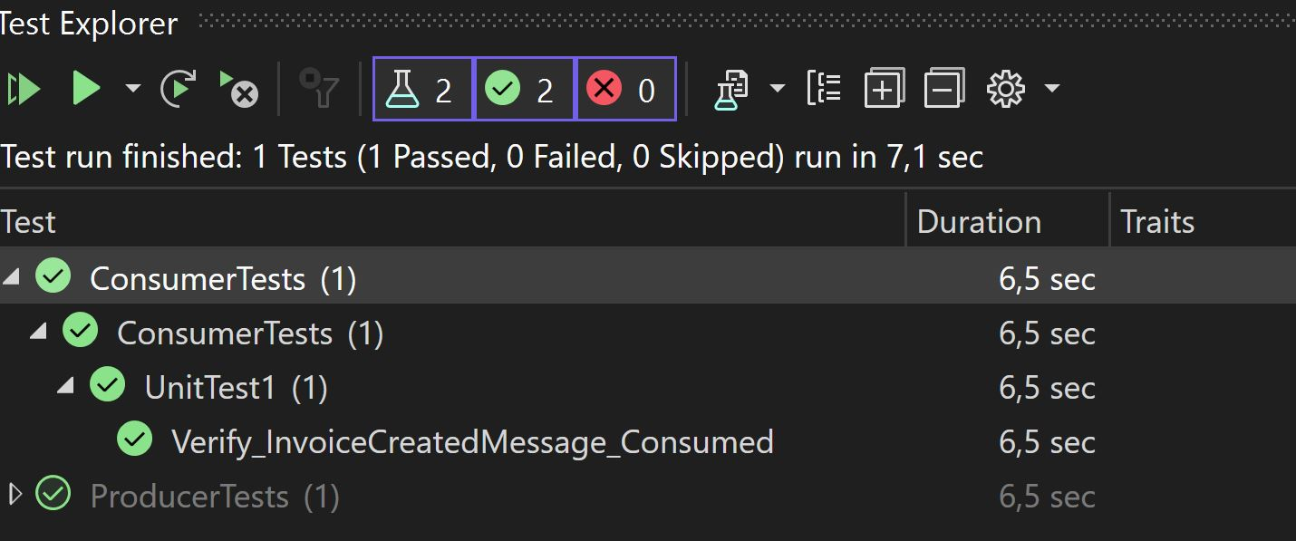



Testing / Consumer
1
Click the Test Window and
Select the Test Explorer
2
Left Click on ConsumerTests and
“Run”

Slide 11
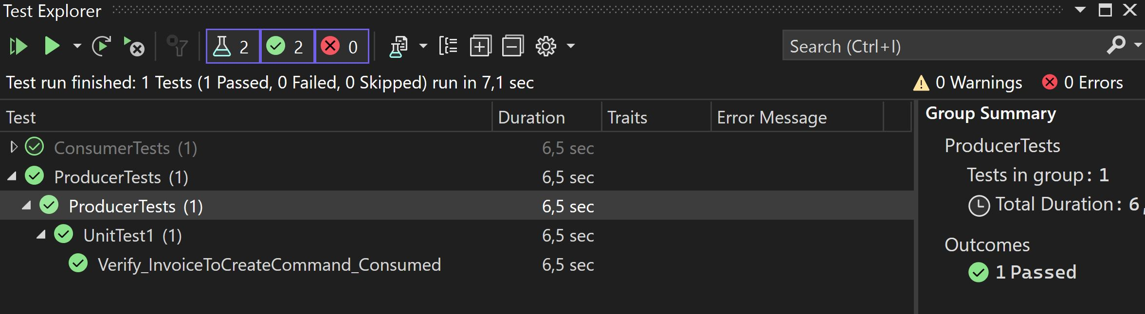


Testing / Producer
1
Click the Test Window and
Select the Test Explorer
2
Left Click on ProducerTests and
“Run”

